Slide 1

WhenToTest.org
Decision Support Tools for
Individuals and Organizations
RADx Tech | March 22, 2022

Slide 2
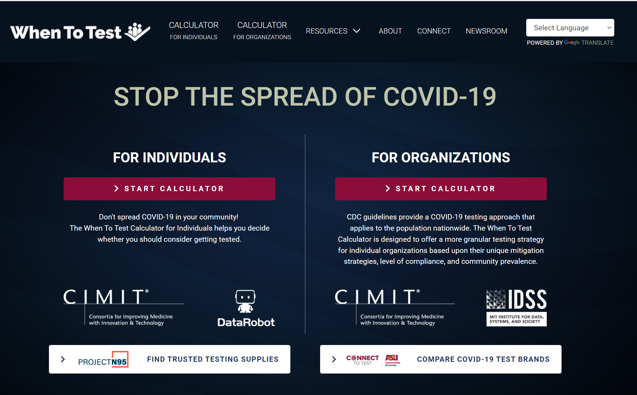

Slide 3


Calculator for Individuals
Decision-support tool for people without symptoms of COVID-19
Makes its recommendations based on how likely you are to get COVID-19 and spread it to other people based upon your behaviors
Your risk of getting infected is driven in part by how many people carry the virus in your area, which is estimated at the county level
Helps the user decide whether they should consider getting tested
USER INPUTS
  State + County
  Vaccination status
  Mask usage
  Recent COVID test results
  Average daily contacts
  Social events – past & future

Slide 4
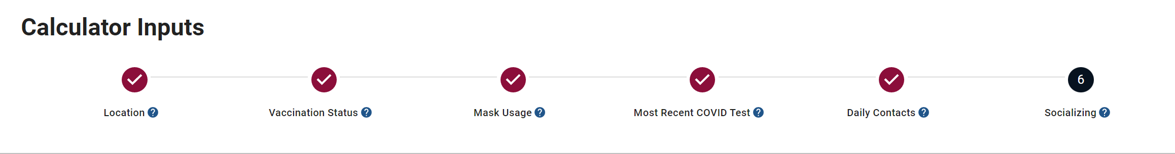
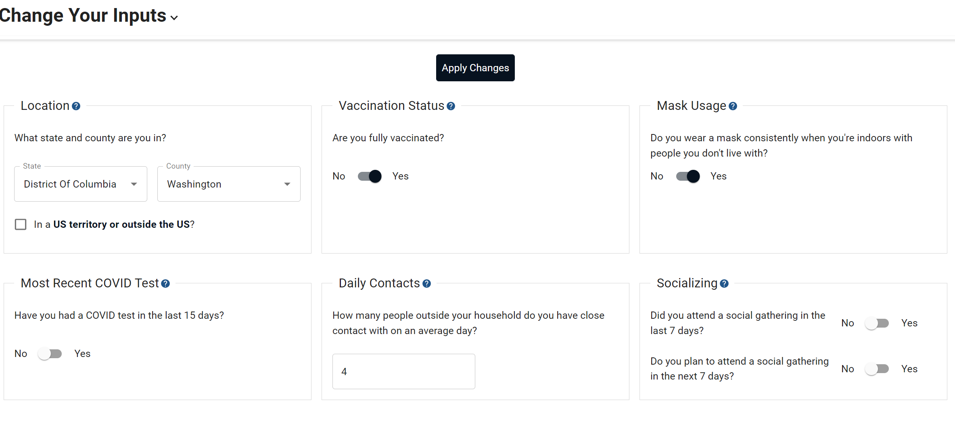
Calculator for Individuals

Slide 5
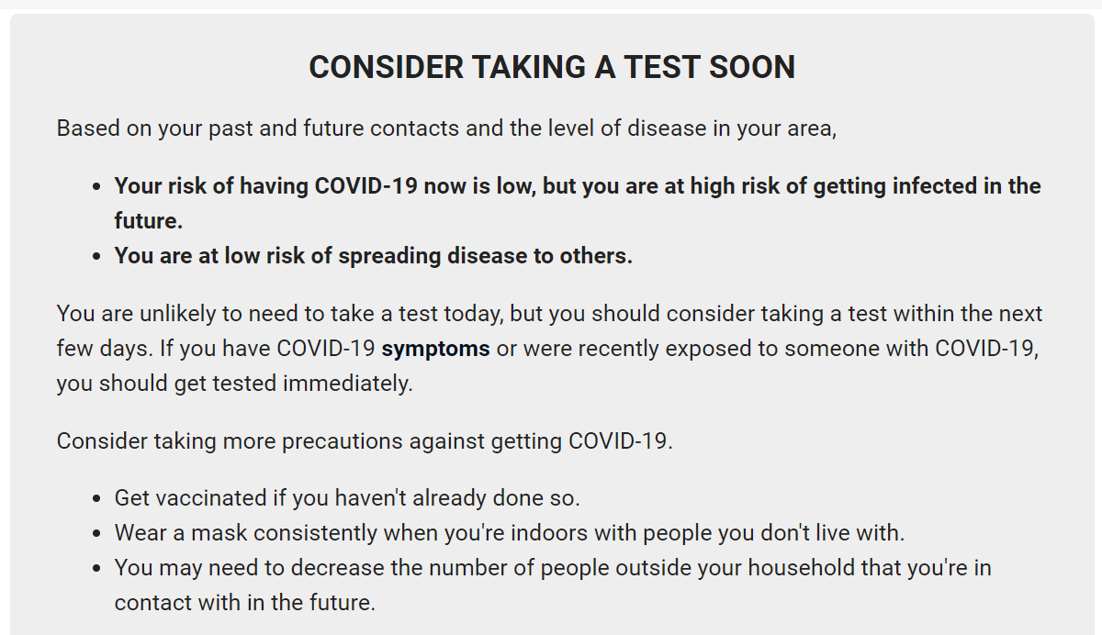
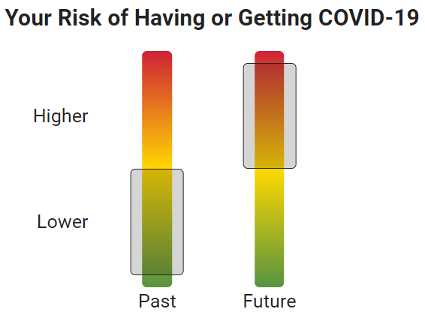
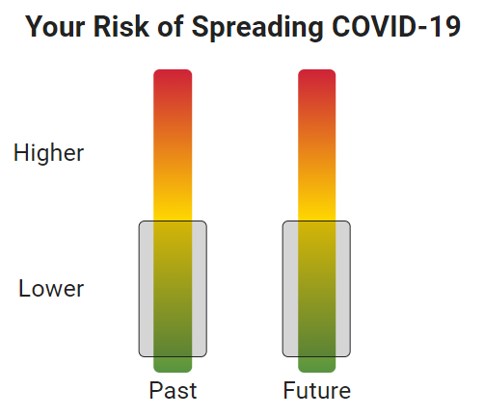
Calculator for Individuals
Location | Vaccination Status | Mask Usage Indoors | Most recent COVID test | Daily Contacts | Socializing (past & present)
Anchorage, Alaska | Fully Vaccinated | No - Does not wear consistently | No | 4 | Yes – past 7 days Yes – future 7 days

Slide 6
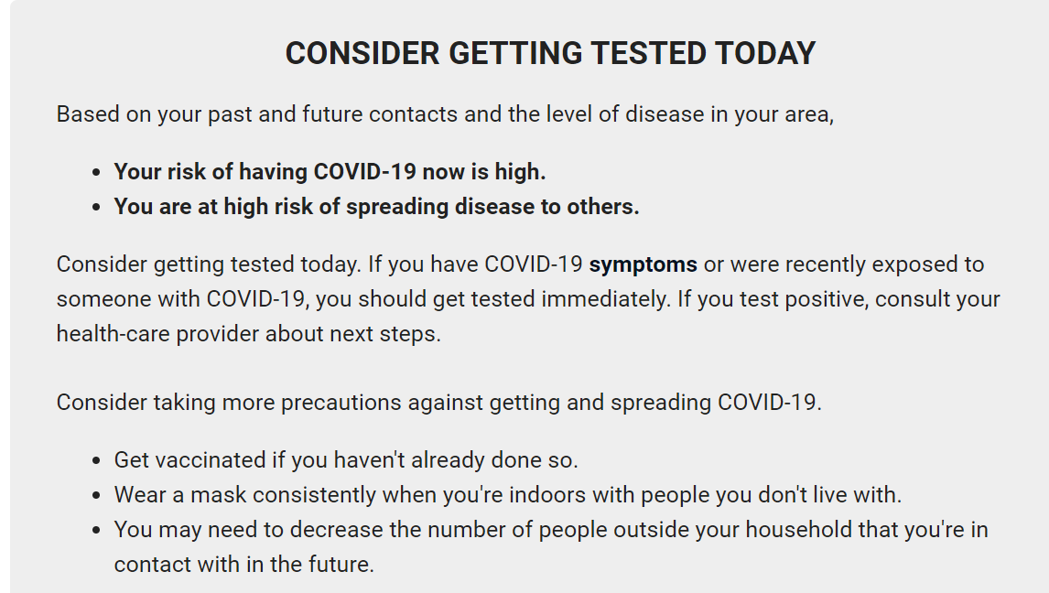
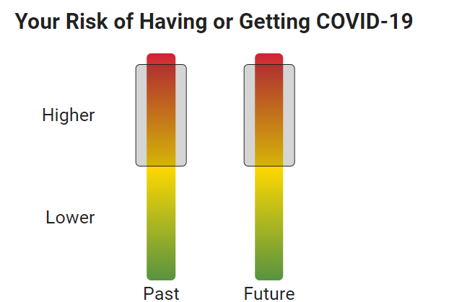
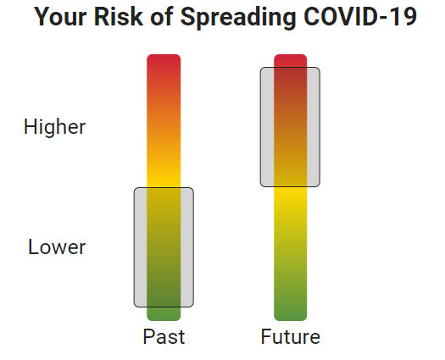
Calculator for Individuals
Location | Vaccination Status | Mask Usage Indoors | Most recent COVID test | Daily Contacts | Socializing (past & present)
Anchorage, Alaska | Not Vaccinated | Yes - Does wear consistently | No | 4 | Yes – past 7 days Yes – future 7 days

Slide 7
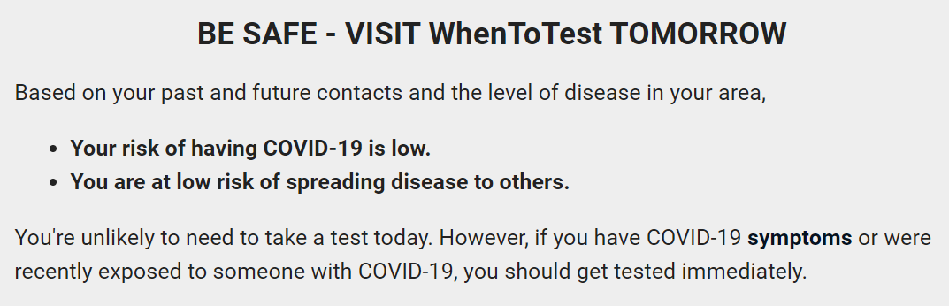
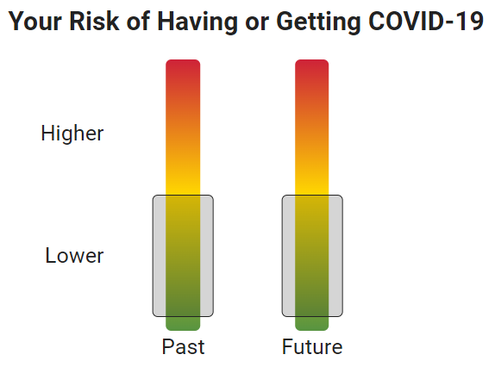
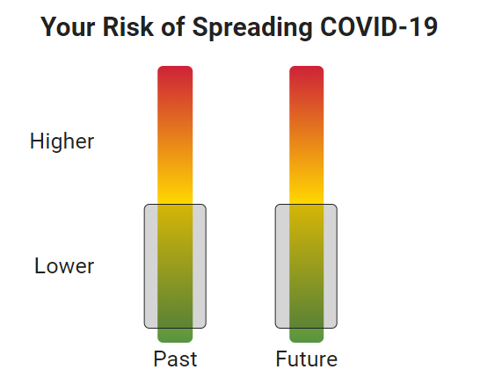
Calculator for Individuals
Location | Vaccination Status | Mask Usage Indoors | Most recent COVID test | Daily Contacts | Socializing (past & present)
Anchorage, Alaska | Fully Vaccinated | Yes - Does wear consistently | No | 4 | No – past 7 days No – future 7 days

Slide 9

Calculator for Organizations
Problem:
Multiple strategies – mask wearing, social distancing, contact tracing, testing - may all be used to reduce the spread of COVID-19
How do we get this information in the hands of organizational leaders to make informed decisions about the best strategy for their community?
Goal:
Create a modeling tool / website that allows businesses, schools, and other organizations to develop a testing approach specific to their use of risk reducing activities
While CDC and other organizations provide general guidance on frequency of testing, and highlight more frequent Antigen testing needed, WhenToTest.org provides granular guidance based on an organization’s unique characteristics.

Slide 10

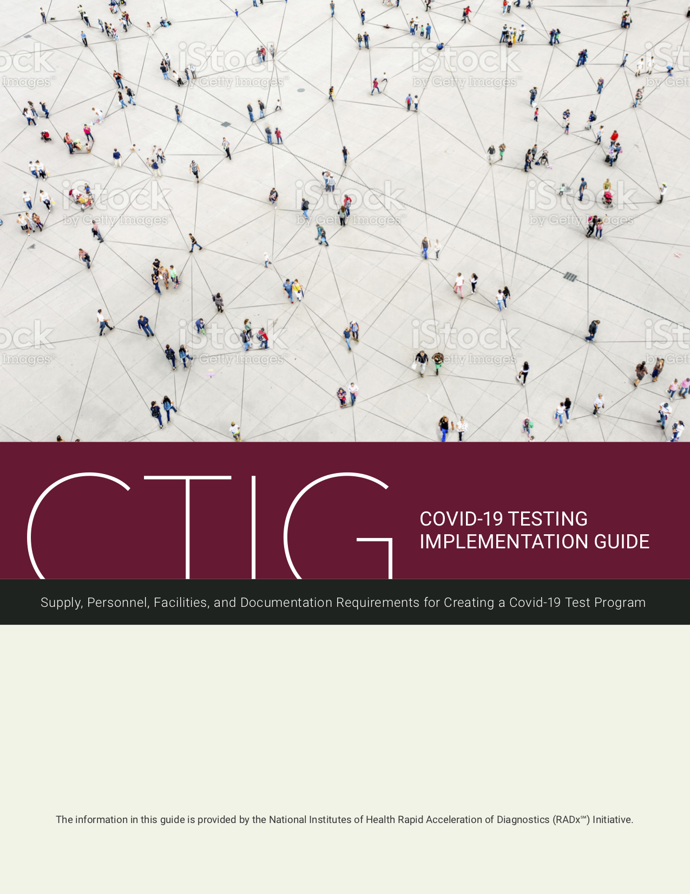

Calculator for Organizations
Support Users with the facts and tools needed to make smart decisions
Educate
Decide to Test
Connect
Educate on Testing
Focus on Schools and Businesses
Facilitate Decisions based on:
Mitigation Strategies
Type of Test
Testing Frequency
Costs
Connect Purchaser with Vendors & Resources:
Project N95
ASU Connect-To-Test

Slide 11
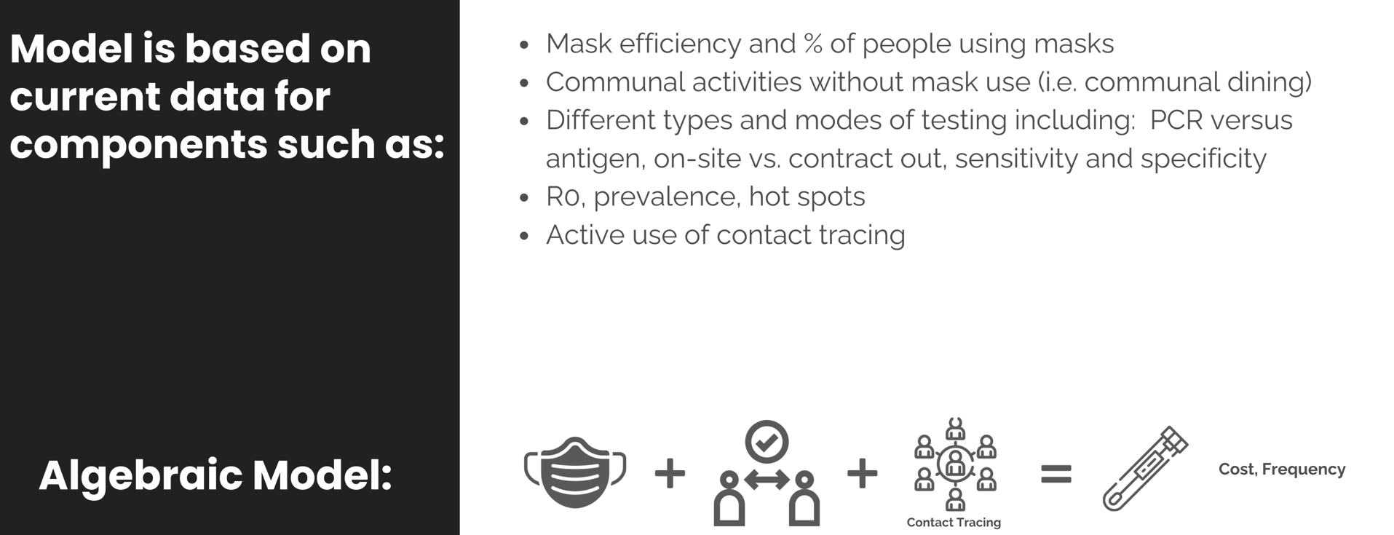

Calculator for Organizations
Notes:
uses a mathematical model developed by MIT’s Institute for Data Systems and Society and CIMIT
to determine how often people in organizations like schools, office, or manufacturing plants need to be tested in order to reduce the chances of a COVID-19 outbreak.
The calculator highlights that how improving mitigation measures will reduce the risk of an outbreak.
Adjusting the inputs will show how increasing vaccination levels, improving mask policies, implementing co-horting, and keeping track of close contacts will affect your need for testing and costs.

Slide 12
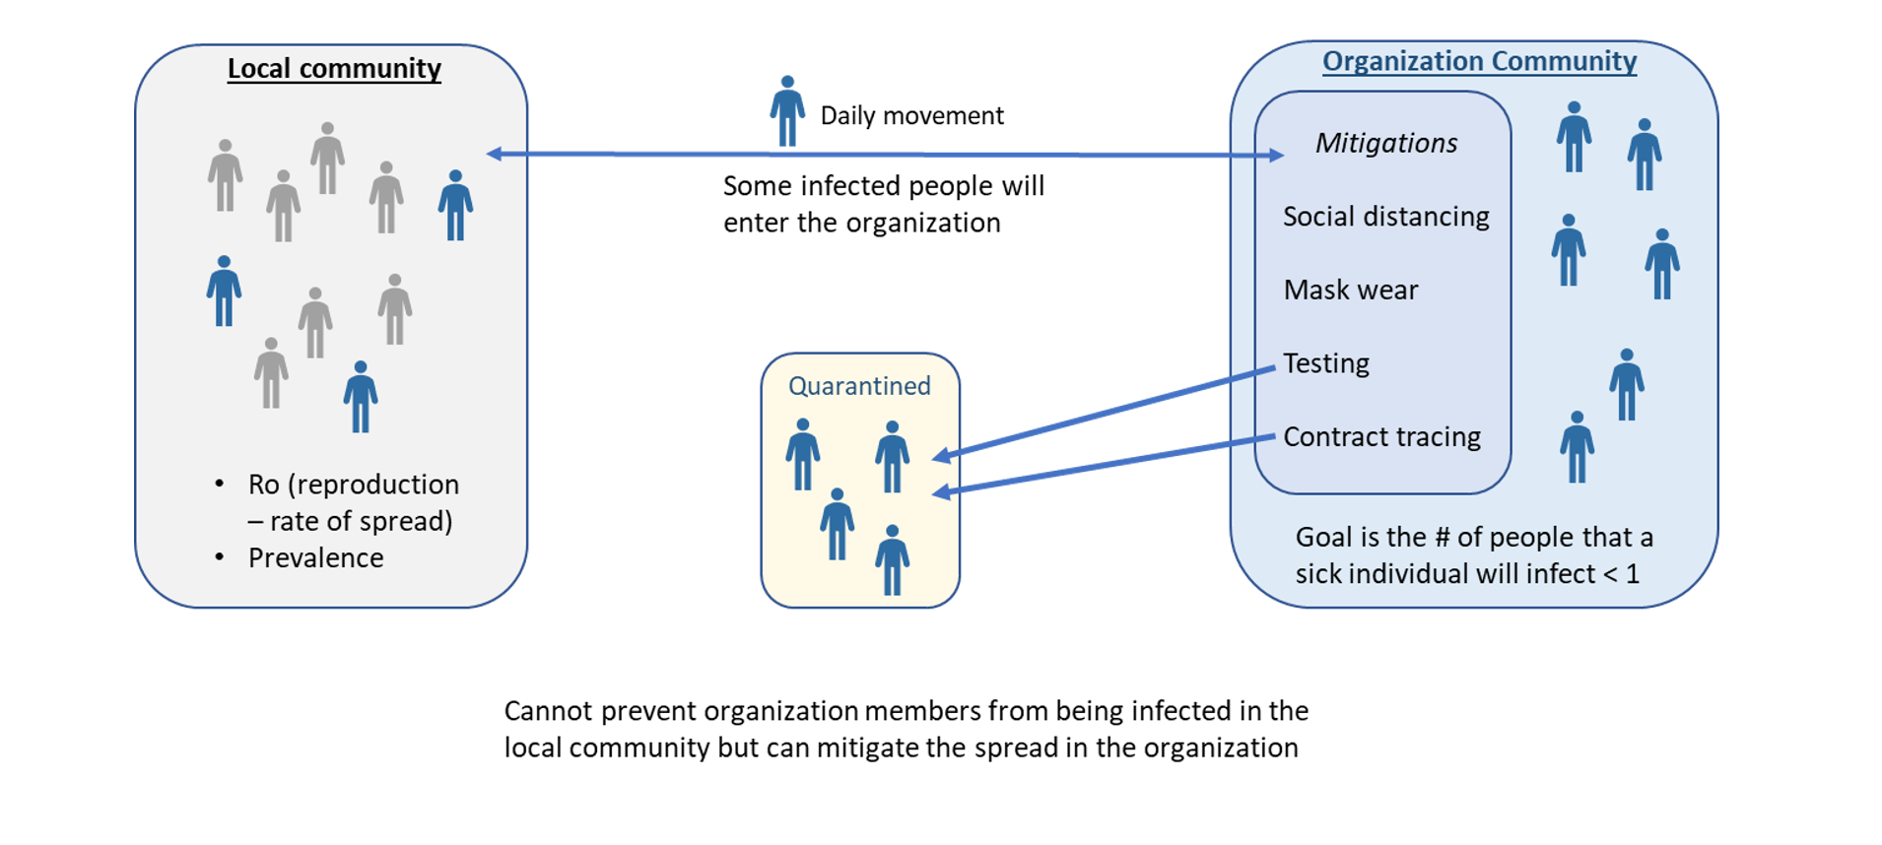
Model focused on Semi-Contained Communities

Slide 13
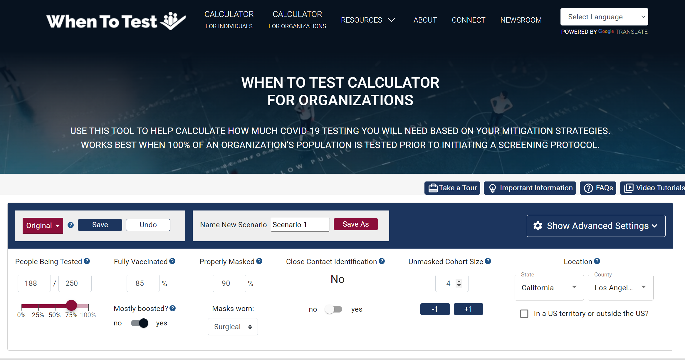

Slide 14
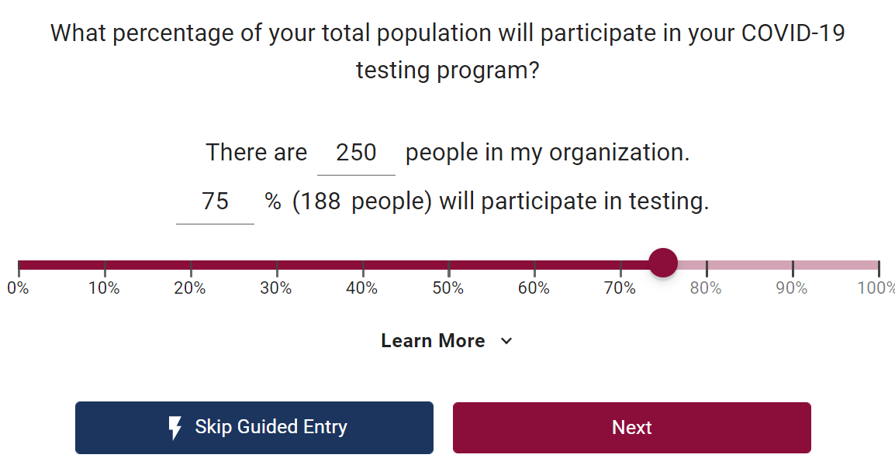
Calculator for Organizations

Slide 15
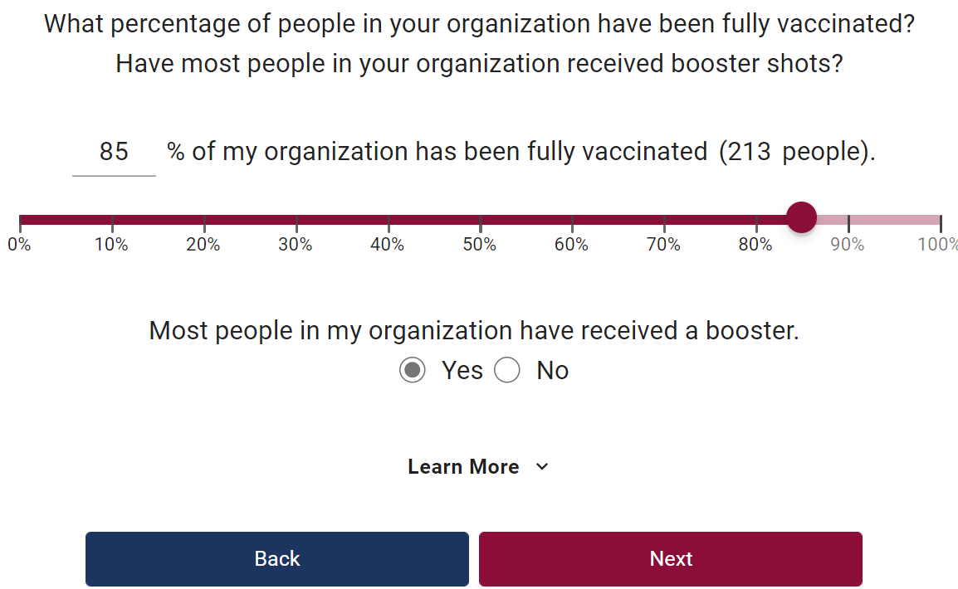
Calculator for Organizations

Slide 16
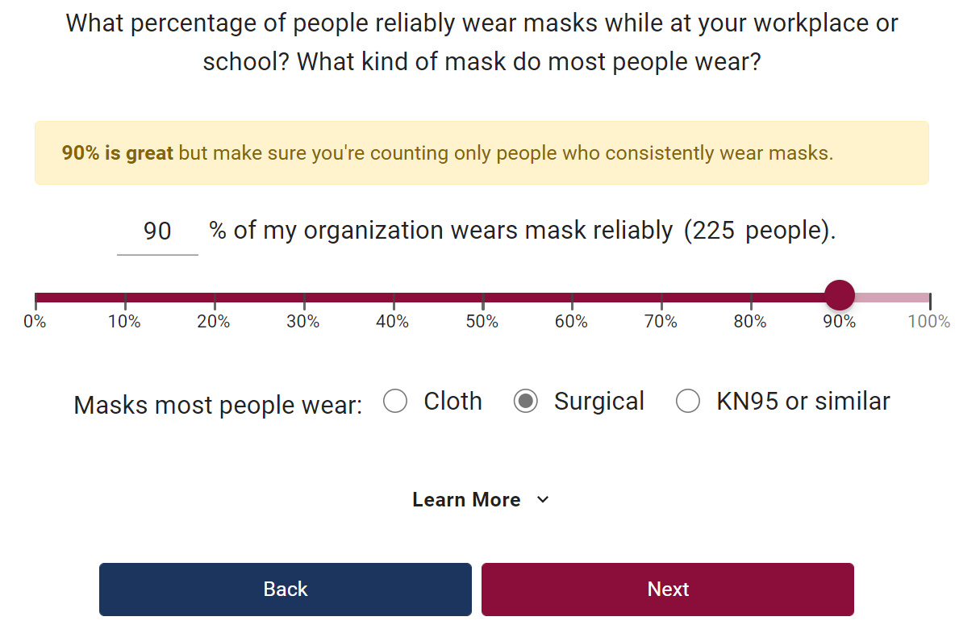
Calculator for Organizations

Slide 17
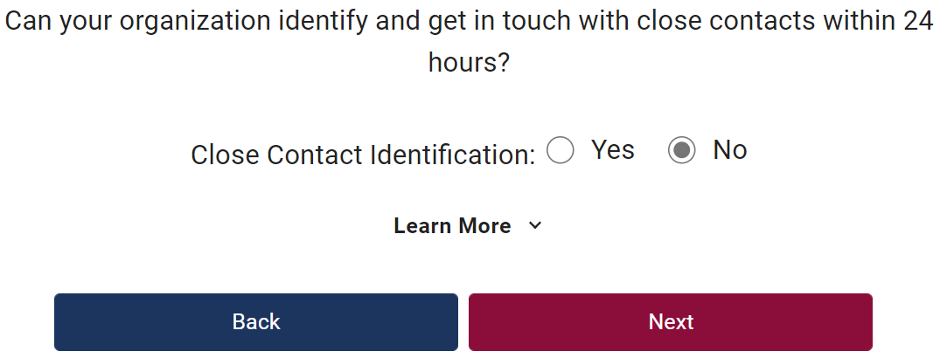
Calculator for Organizations

Slide 18
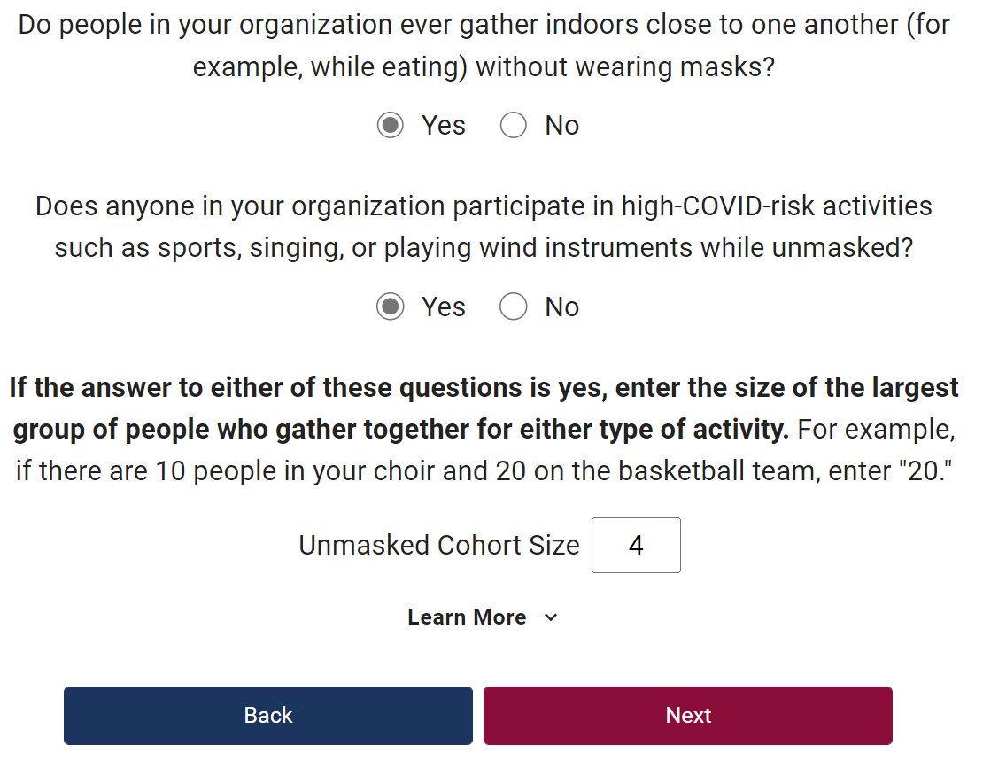
Calculator for Organizations

Slide 19
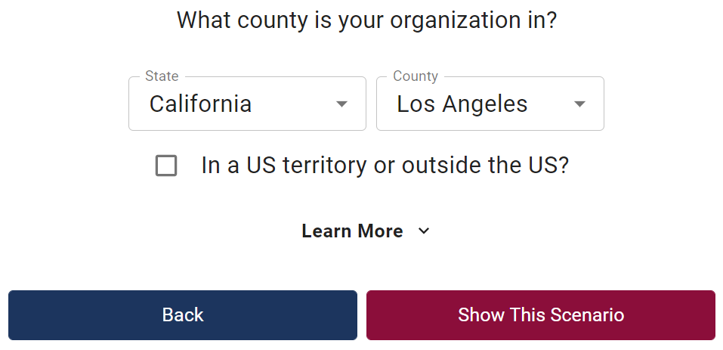
Calculator for Organizations

Slide 20
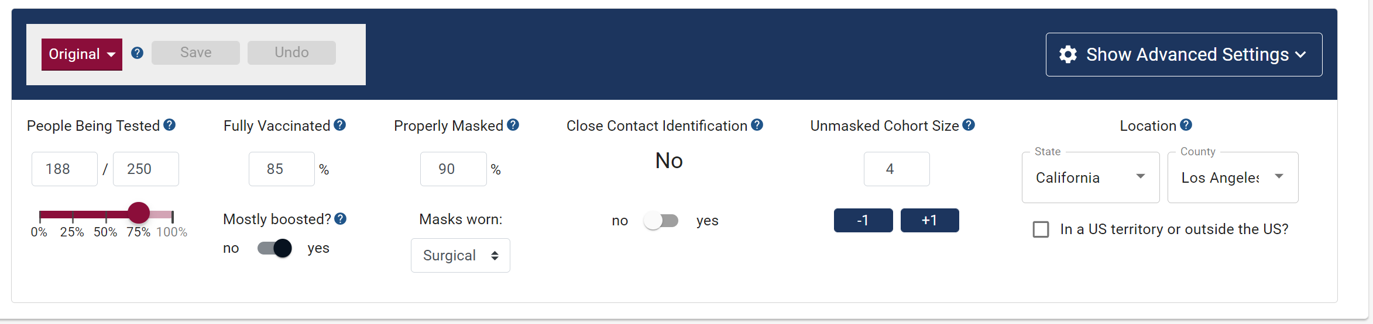
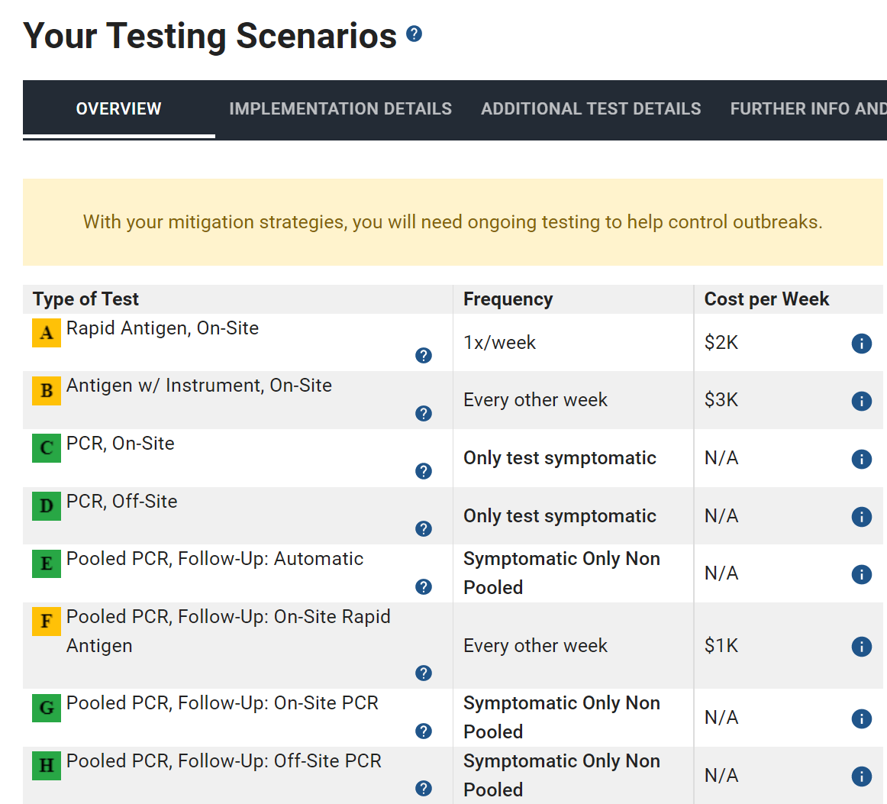
RADx Tech | March 4, 2022

Slide 21
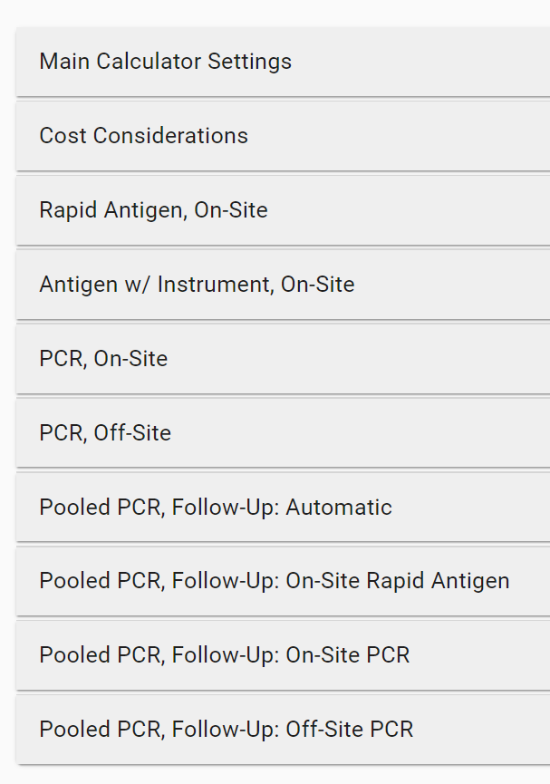
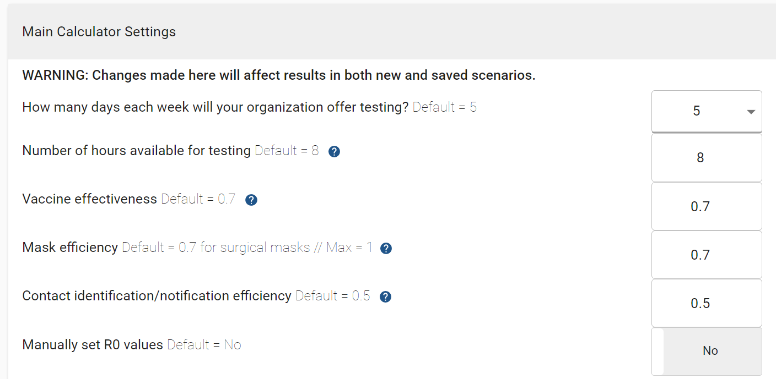

Slide 22
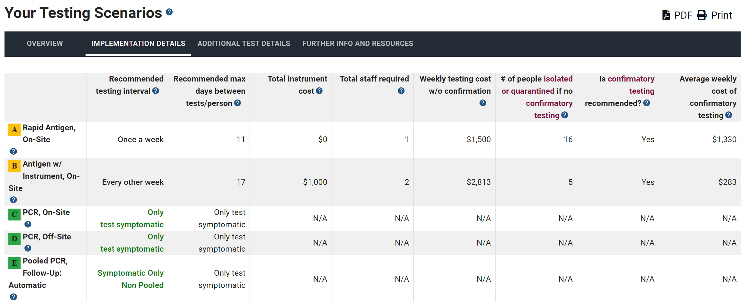

Slide 23
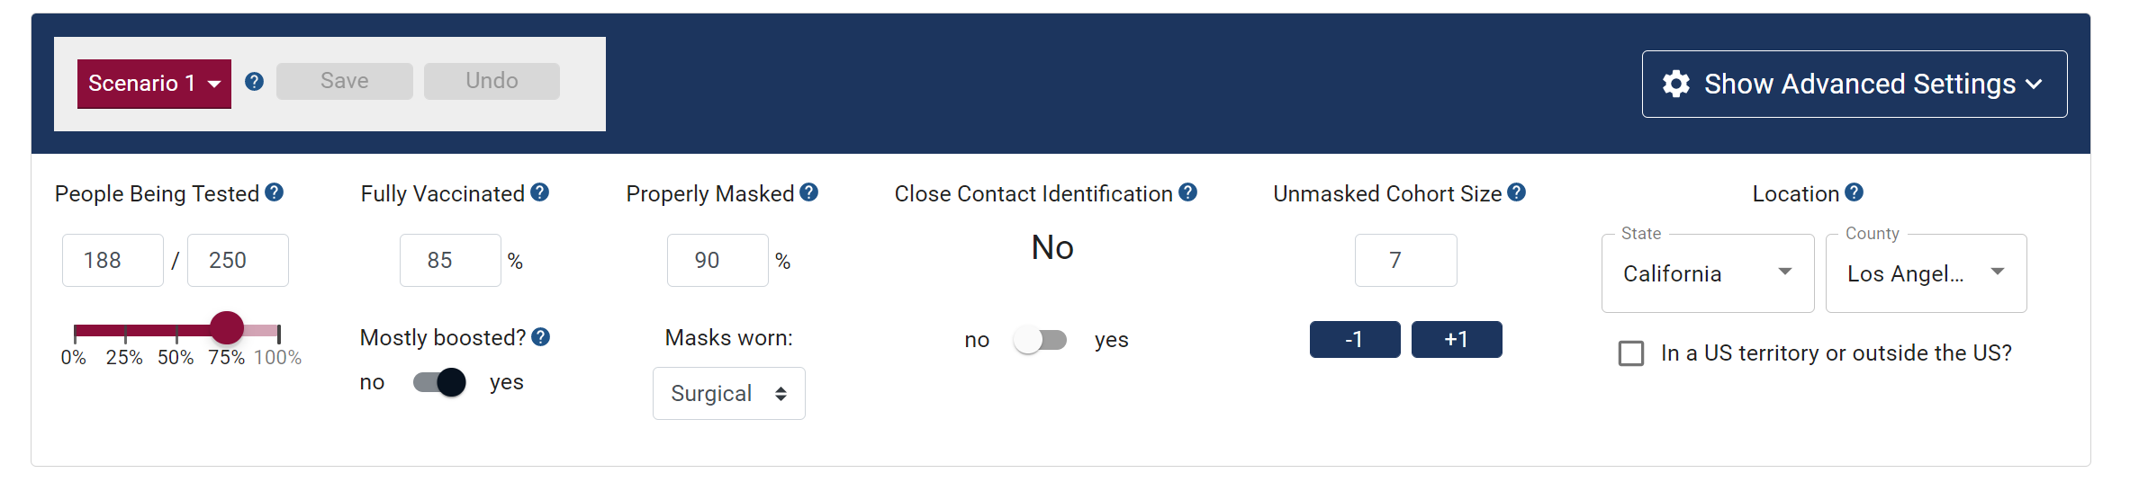
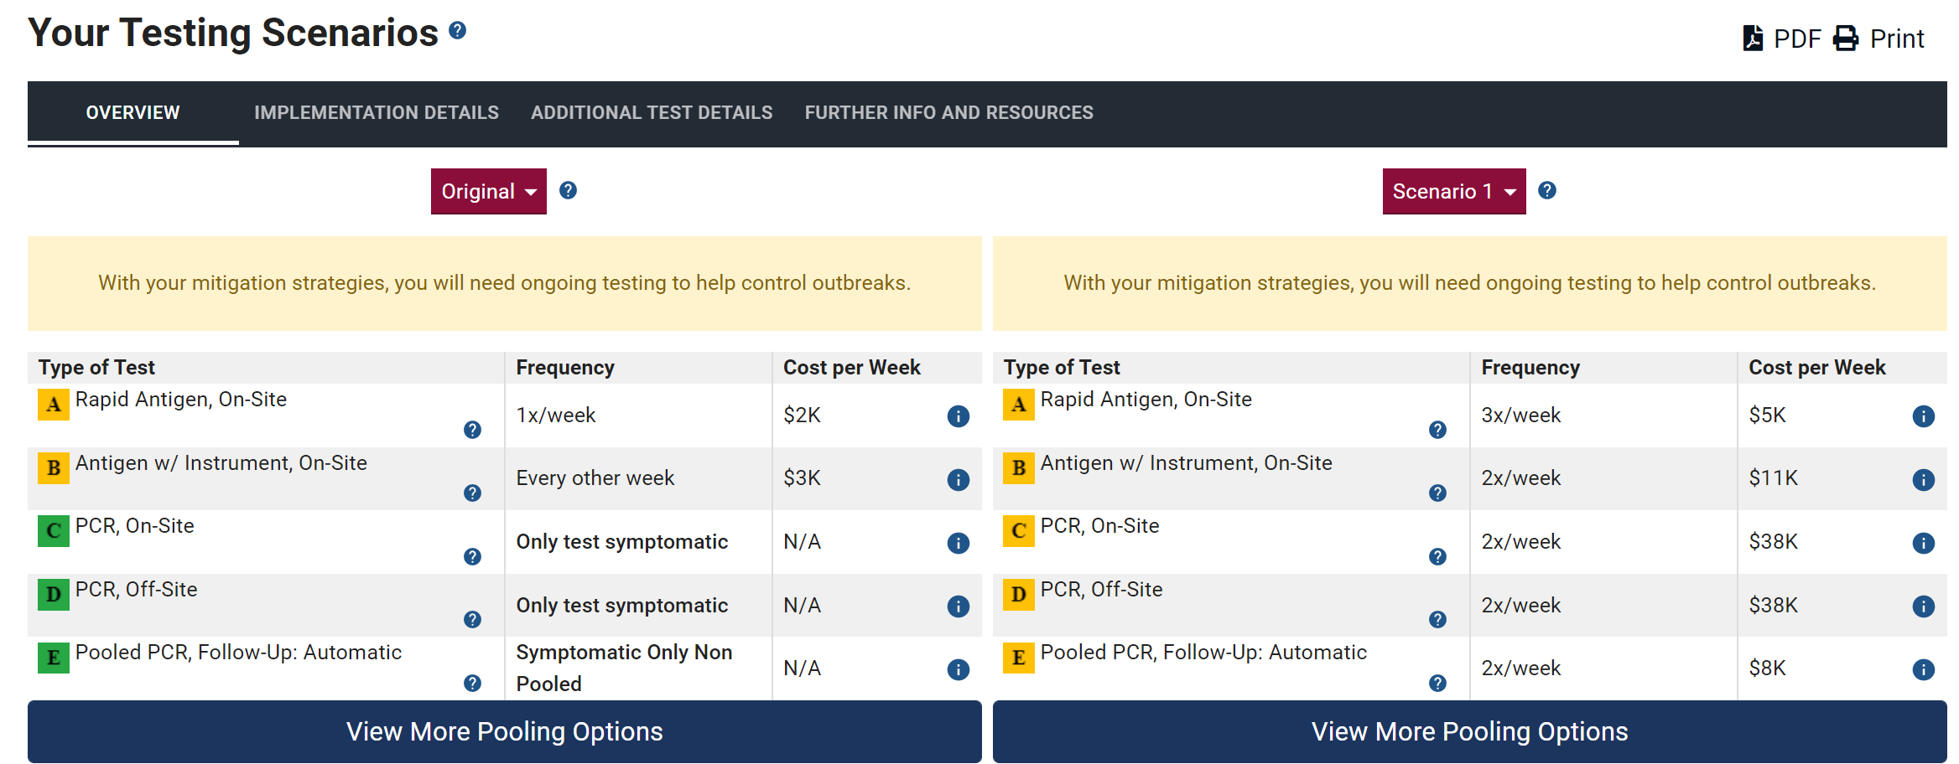
RADx Tech | March 4, 2022

Slide 24
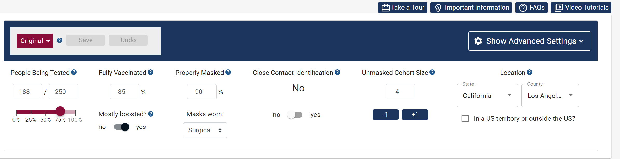

Slide 25
Future Development
Enhance site to support Serial Testing
Enhance model to provide event-based guidance
  Attending a wedding, Meeting with friends, Visiting grandparents
Continuous updates
  Dominant variant
  Prevalence data
RADx Tech | March 22, 2022

Slide 26
THANK YOU !
Your suggestions are welcome…
MyCOVIDToolkit.org
WhenToTest.org
Created by RADx Tech, Funded by NIBIB
Presented by: Eric Norman & Susan Moreira
RADx Tech | March 22, 2022

